Slide 1
Java Lambda Expressions
Lambda Expressions were added in Java 8.
A lambda expression is a short block of code which takes in parameters and returns a value.
Lambda expressions are similar to methods, but they do not need a name and they can be implemented right in the body of a method.

Slide 2
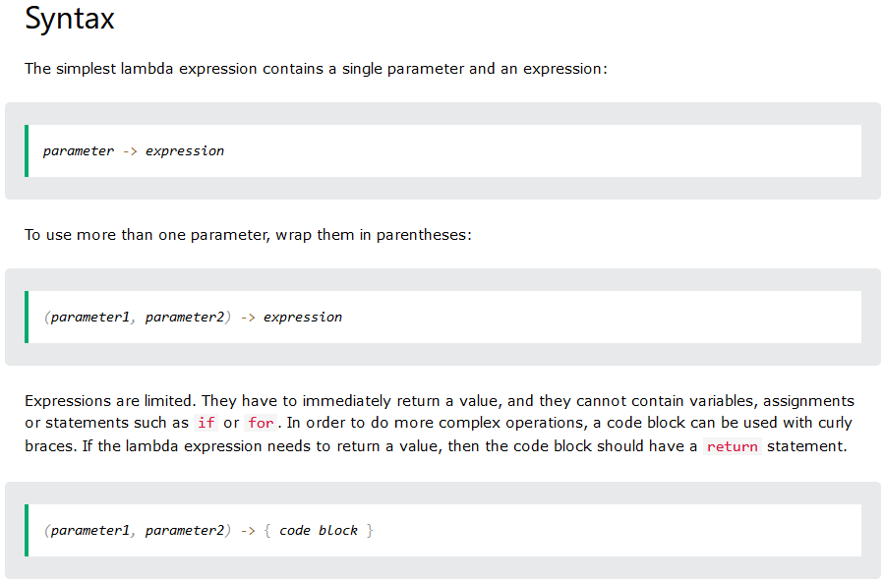

Slide 3
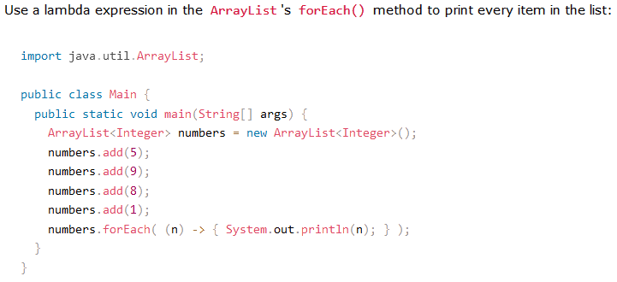
Using Lambda Expressions
Lambda expressions are usually passed as parameters to a function:

Slide 4
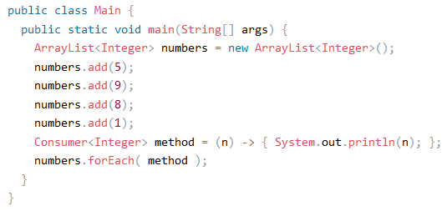
Consumer Interface
Lambda expressions can be stored in variables if the variable's type is an interface which has only one method.
The lambda expression should have the same number of parameters and the same return type as that method.
Java has many of these kinds of interfaces built in, such as the Consumer interface (found in the java.util package) used by lists.

Slide 5
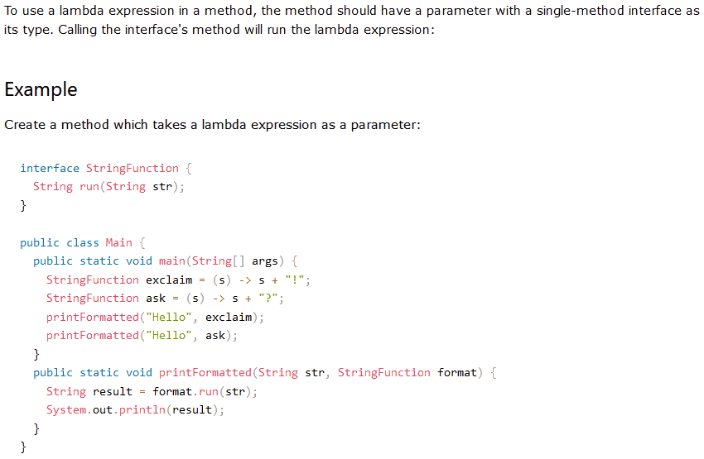

Slide 6
Functionalities of Lambda Expression
Lambda Expressions implement the only abstract function and therefore implement functional interfaces lambda expressions are added in Java 8 and provide the below functionalities.
Functional Interfaces:
A functional interface is an interface that contains only one abstract method.
Code as Data:
Treat functionality as a method argument.
Class Independence:
Create functions without defining a class.
Pass and Execute:
Pass lambda expressions as objects and execute on demand.

Slide 7
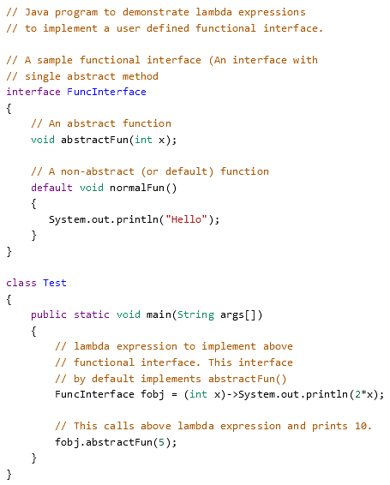

Slide 8
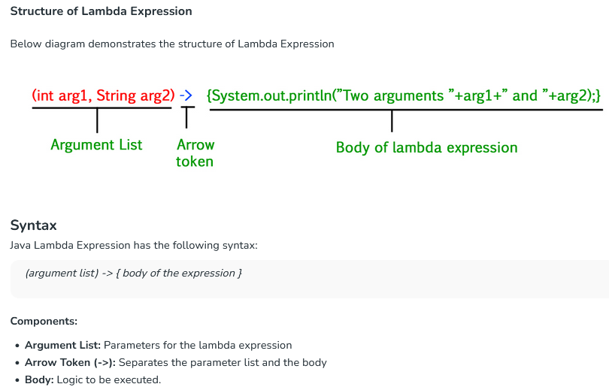

Slide 9
Lambda Expression Parameters
There are three Lambda Expression Parameters are mentioned below:
Zero Parameter
Single Parameter
Multiple Parameters

Slide 10
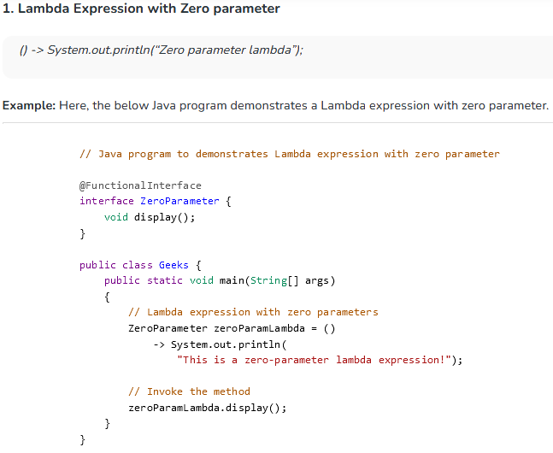

Slide 11
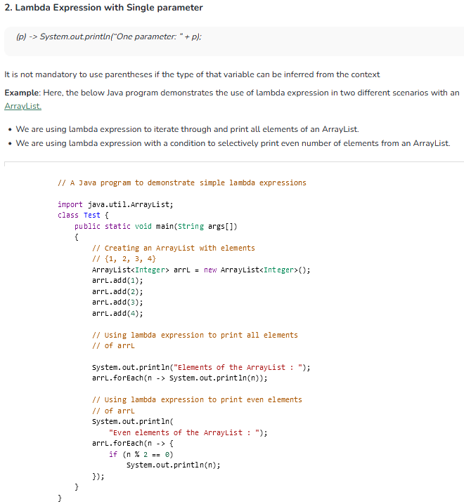

Slide 12
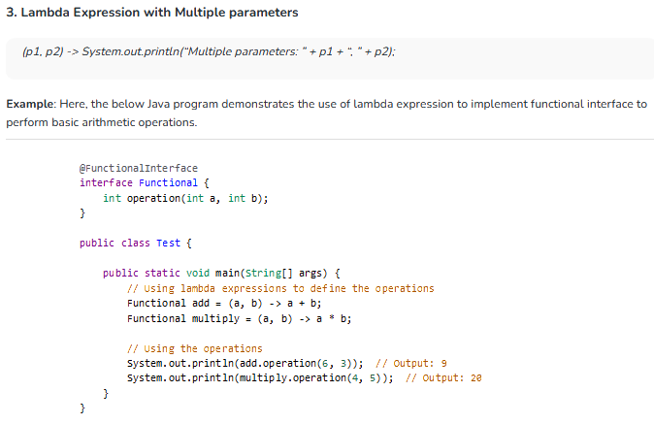

Slide 13
Review Question:
Based on the syntax rules just shown, which of the following is/are NOT valid lambda expressions?
() -> {};
() -> “some string”;
() -> { return “some string”;};
(Integer i) -> return “some string” + i;
(String s) -> {“some string”;};

Slide 14
Answer:
4 and 5 are invalid lambdas, the rest are valid.
Details:
This lambda has no parameters and returns void.
It’s similar to a method with an empty body: public void run() { }.
This lambda has no parameters and returns a String as an expression.
This lambda has no parameters and returns a String (using an explicit return statement, within a block).
return is a control-flow statement. To make this lambda valid, curly braces are required as follows: (Integer i) -> { return “some string” + i; }.
“some string” is an expression, not a statement. To make this lambda valid, you can remove the curly braces and semicolon as follows:
(String s) -> “some string”.
Or if you prefer, you can use an explicit return statement as follows:
(String s) -> { return “some string”; }.

